Slide 1
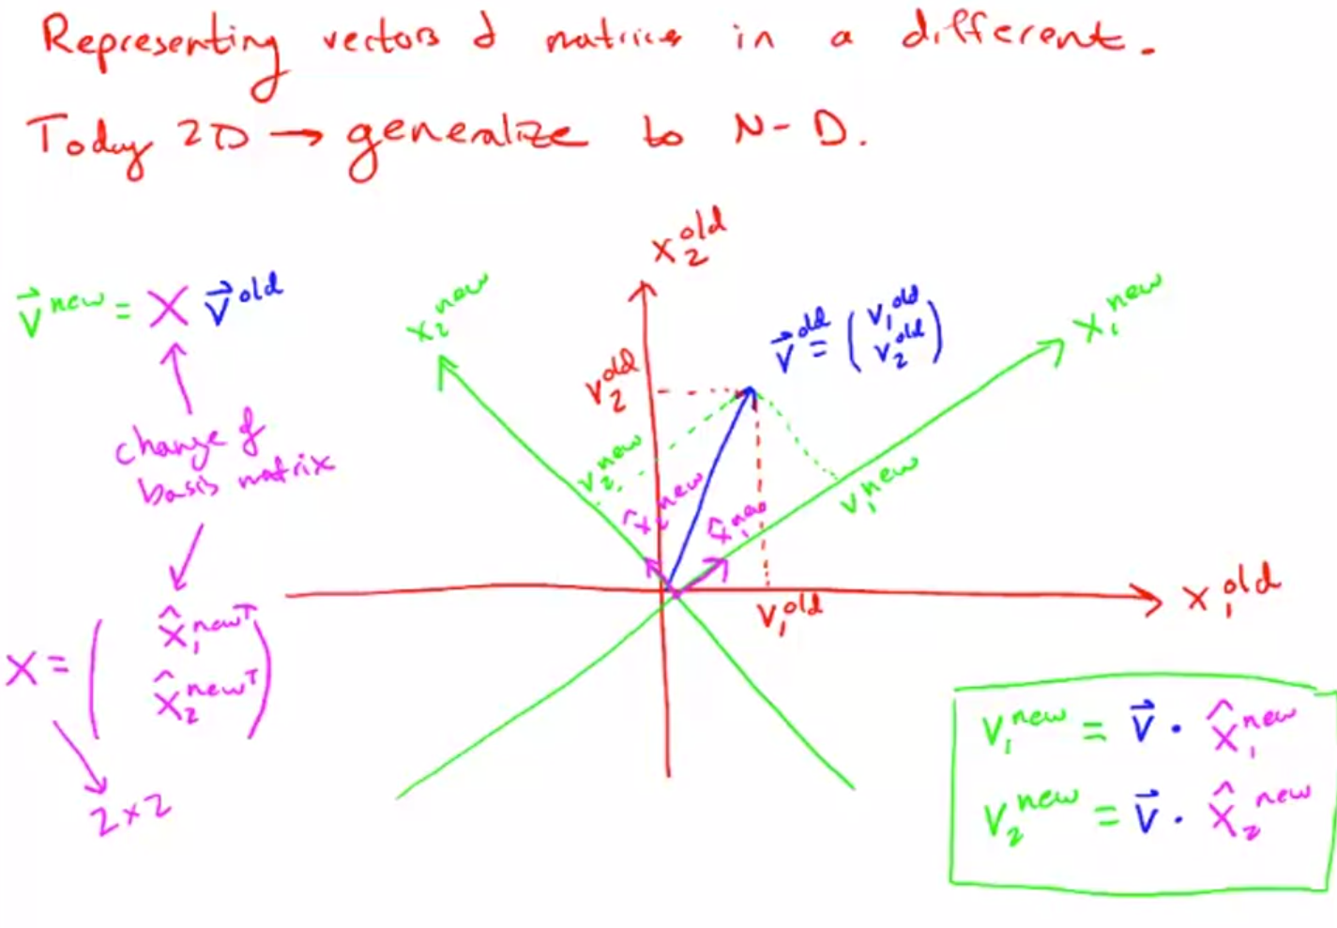

Slide 2
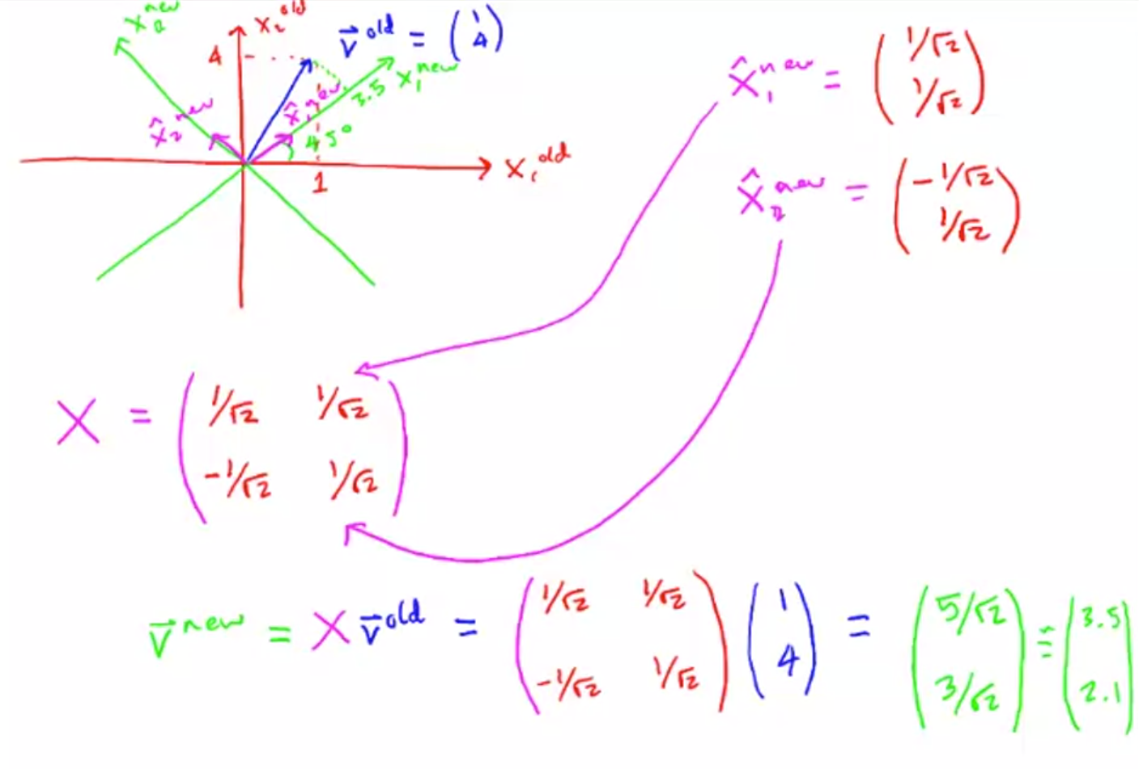

Slide 3
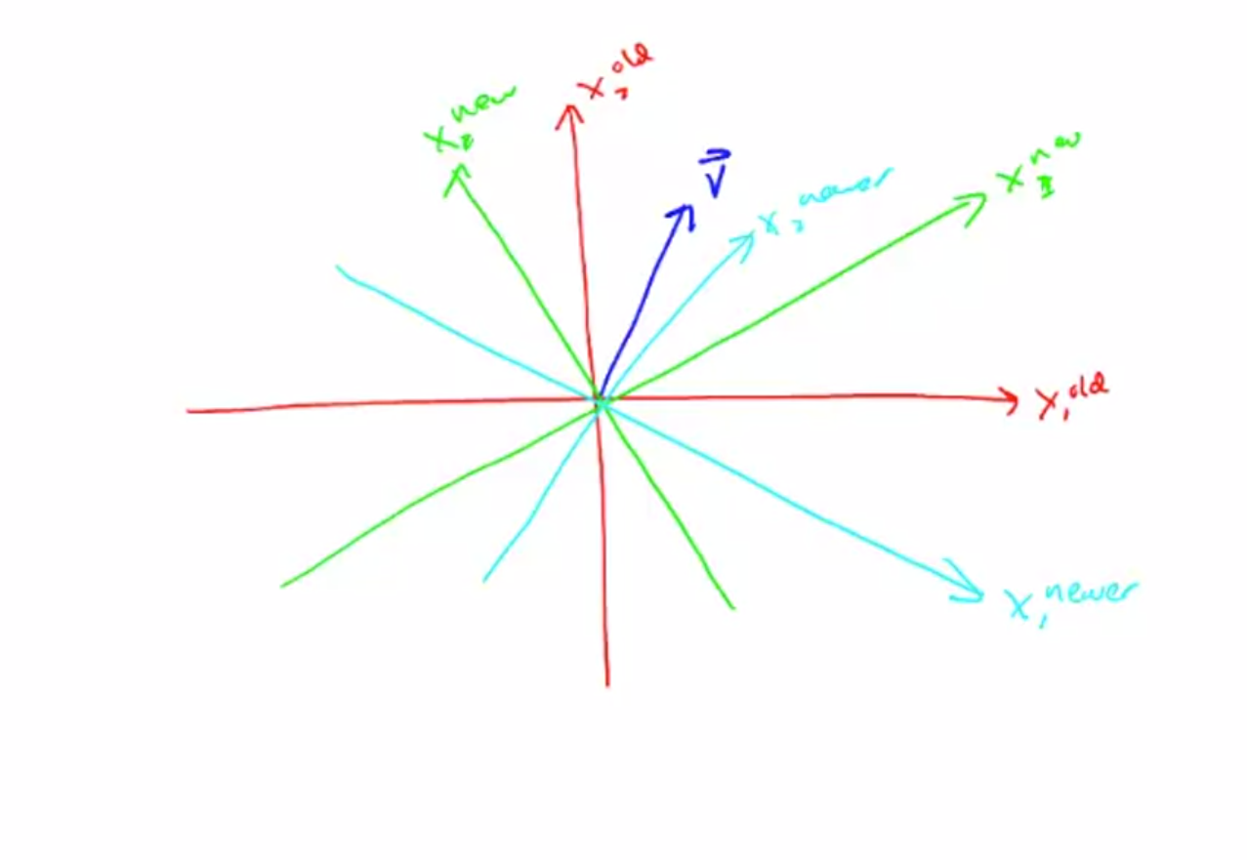

Slide 4
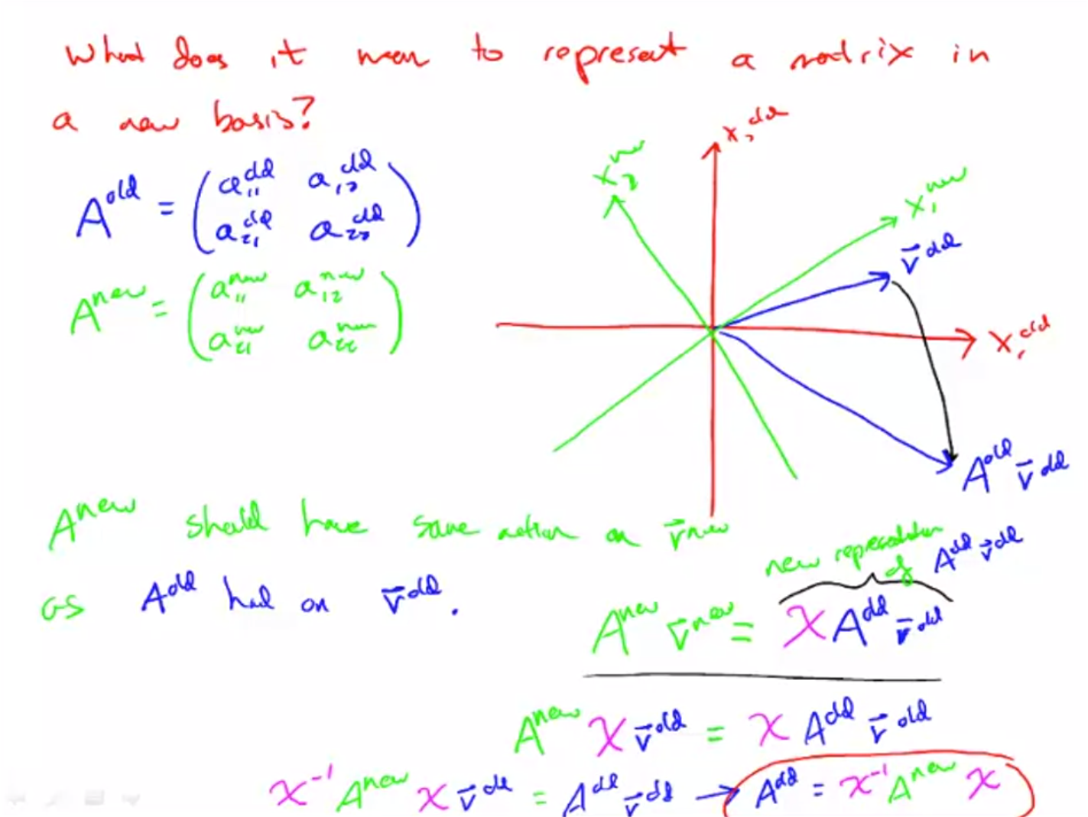
Notes:
What a matrix does, is to take one vector and map it to a new vector.
So this new vector is a A_old times v_old, and that's all it does.
A matrix takes one vector and spits out a new vector.
And if it's a square matrix then it'll spit out the new vector in the same vector space as the old vector.

Slide 5
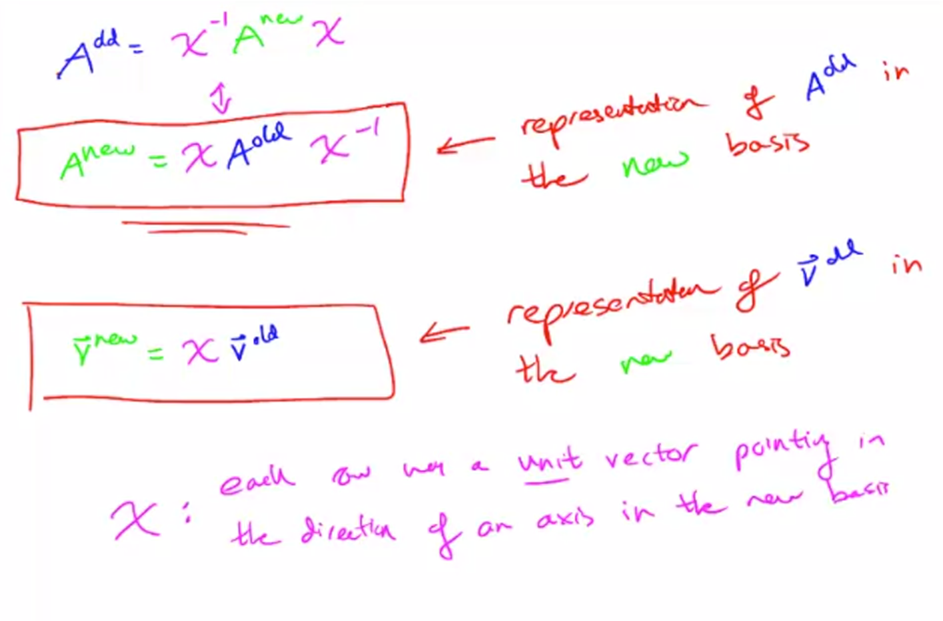

Slide 6
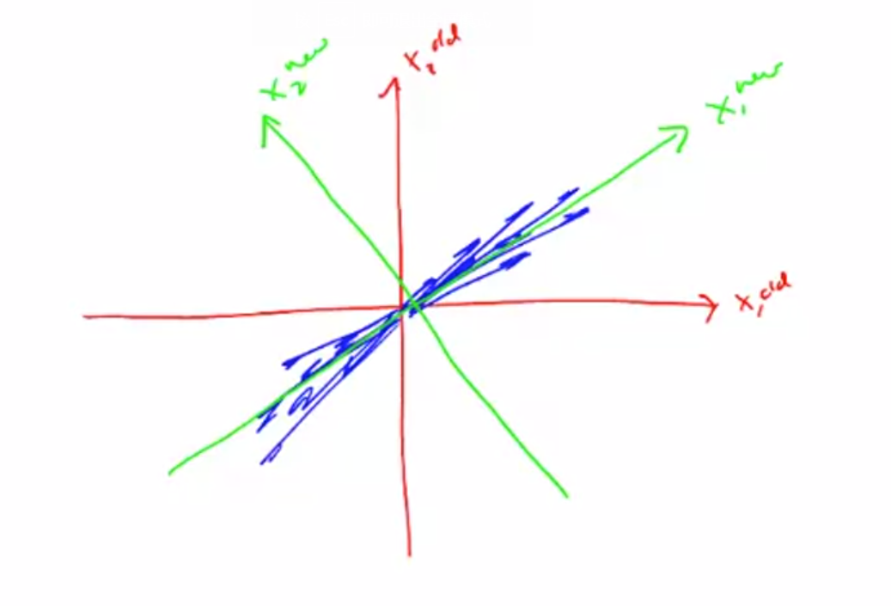
Notes:
Decorrelate

